Slide 1



1926 (?)

Slide 2

1927 (?)

Slide 3

1928 (?)

Slide 4

1929 (?)

Slide 5

1930 (?)

Slide 6

1931

Slide 7

1932

Slide 8
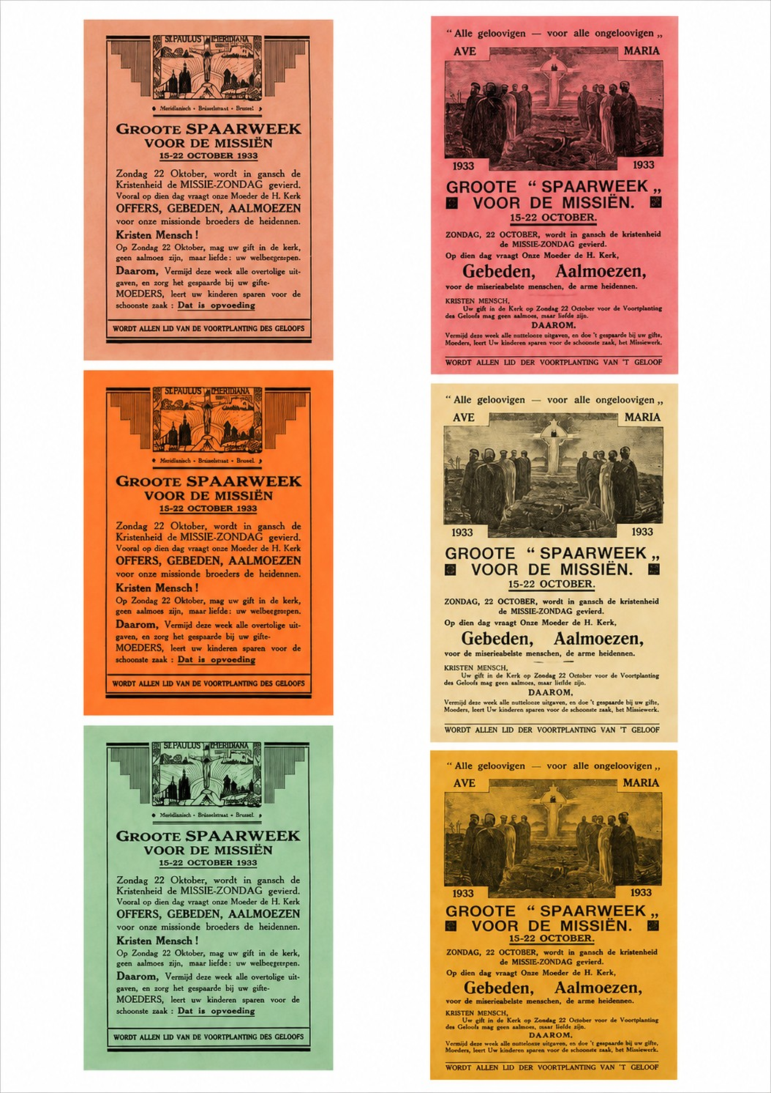
1933

Slide 9

1934

Slide 10

1935

Slide 11

1936

Slide 12

1937

Slide 13

1938

Slide 14

1939

Slide 15

1940

Slide 16

1941

Slide 17

1942

Slide 18

1943

Slide 19
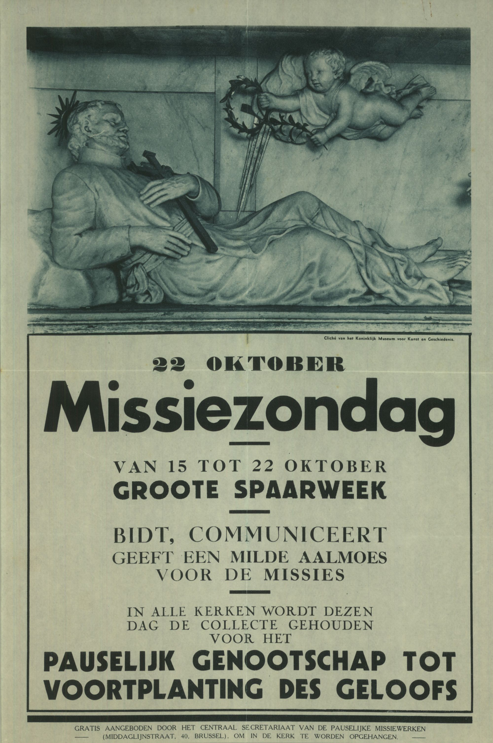
1944

Slide 20

1945

Slide 21

1946

Slide 22

1947

Slide 23

1948

Slide 24

1949

Slide 25

1950

Slide 26
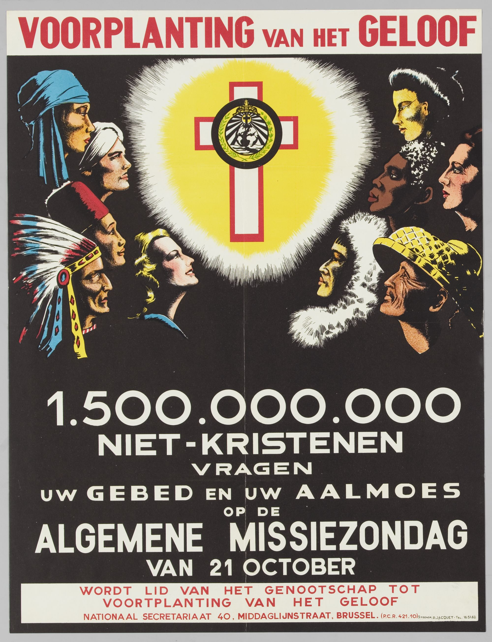
1951

Slide 27

1952

Slide 28

1953

Slide 29

1954

Slide 30

1955

Slide 31

1956

Slide 32

1957

Slide 33

1958

Slide 34
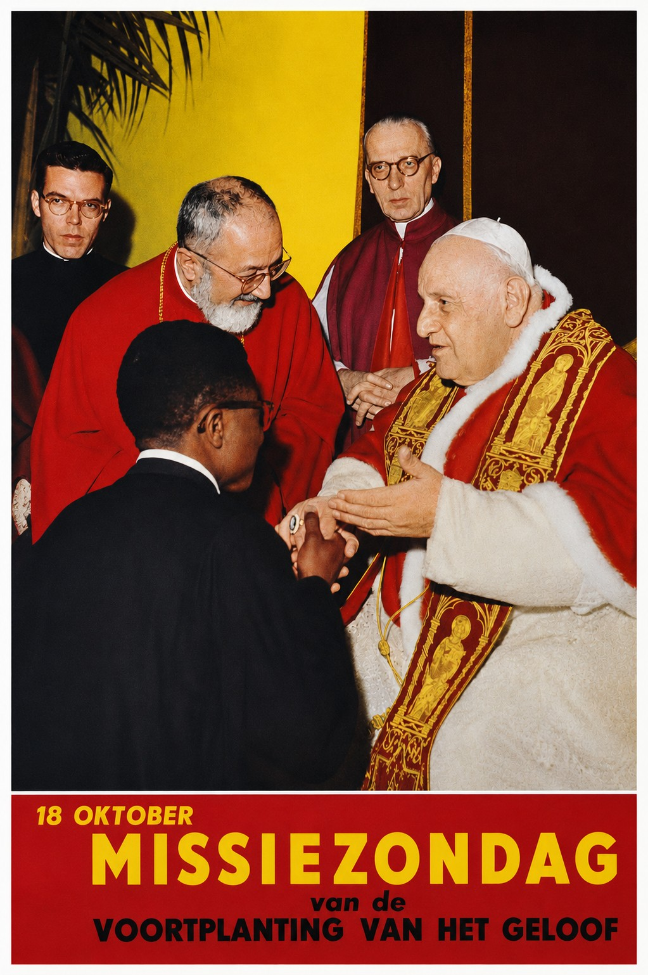
1960

Slide 35

1960

Slide 36
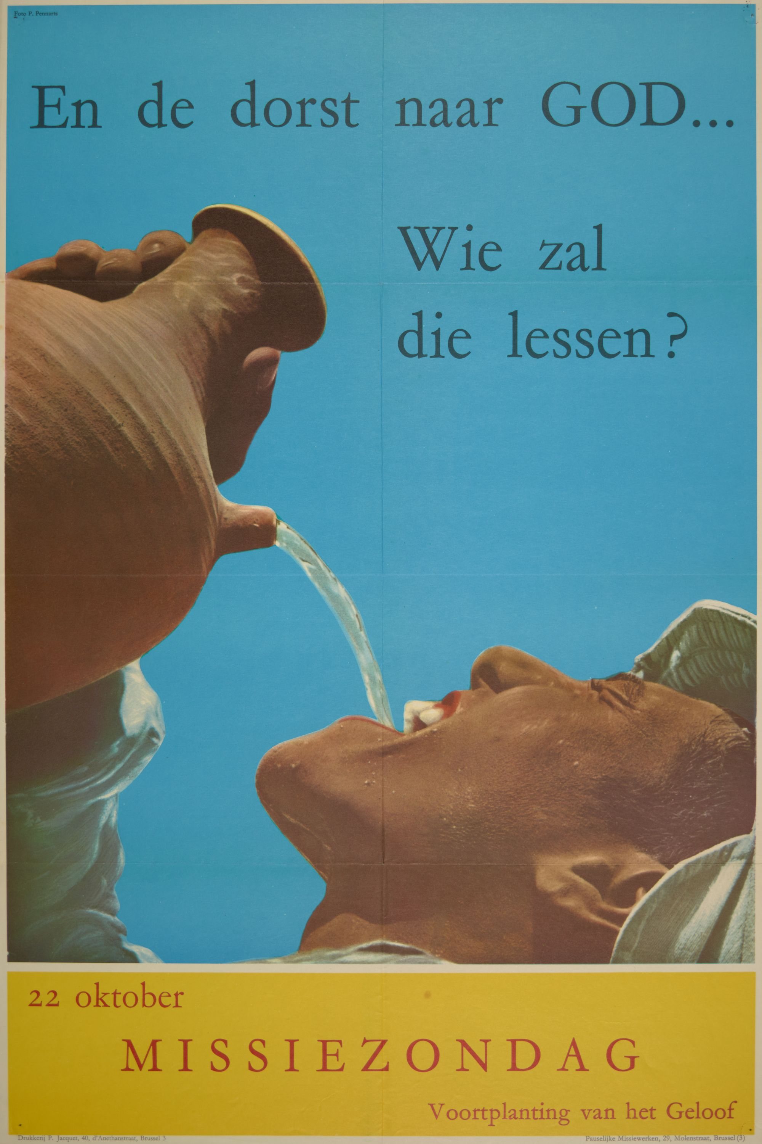
1961

Slide 37
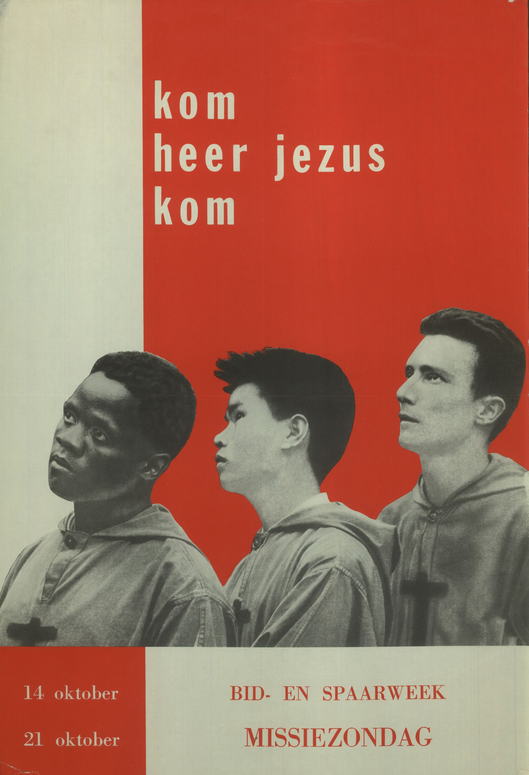
1962

Slide 38

1963

Slide 39

1964

Slide 40

1965

Slide 41
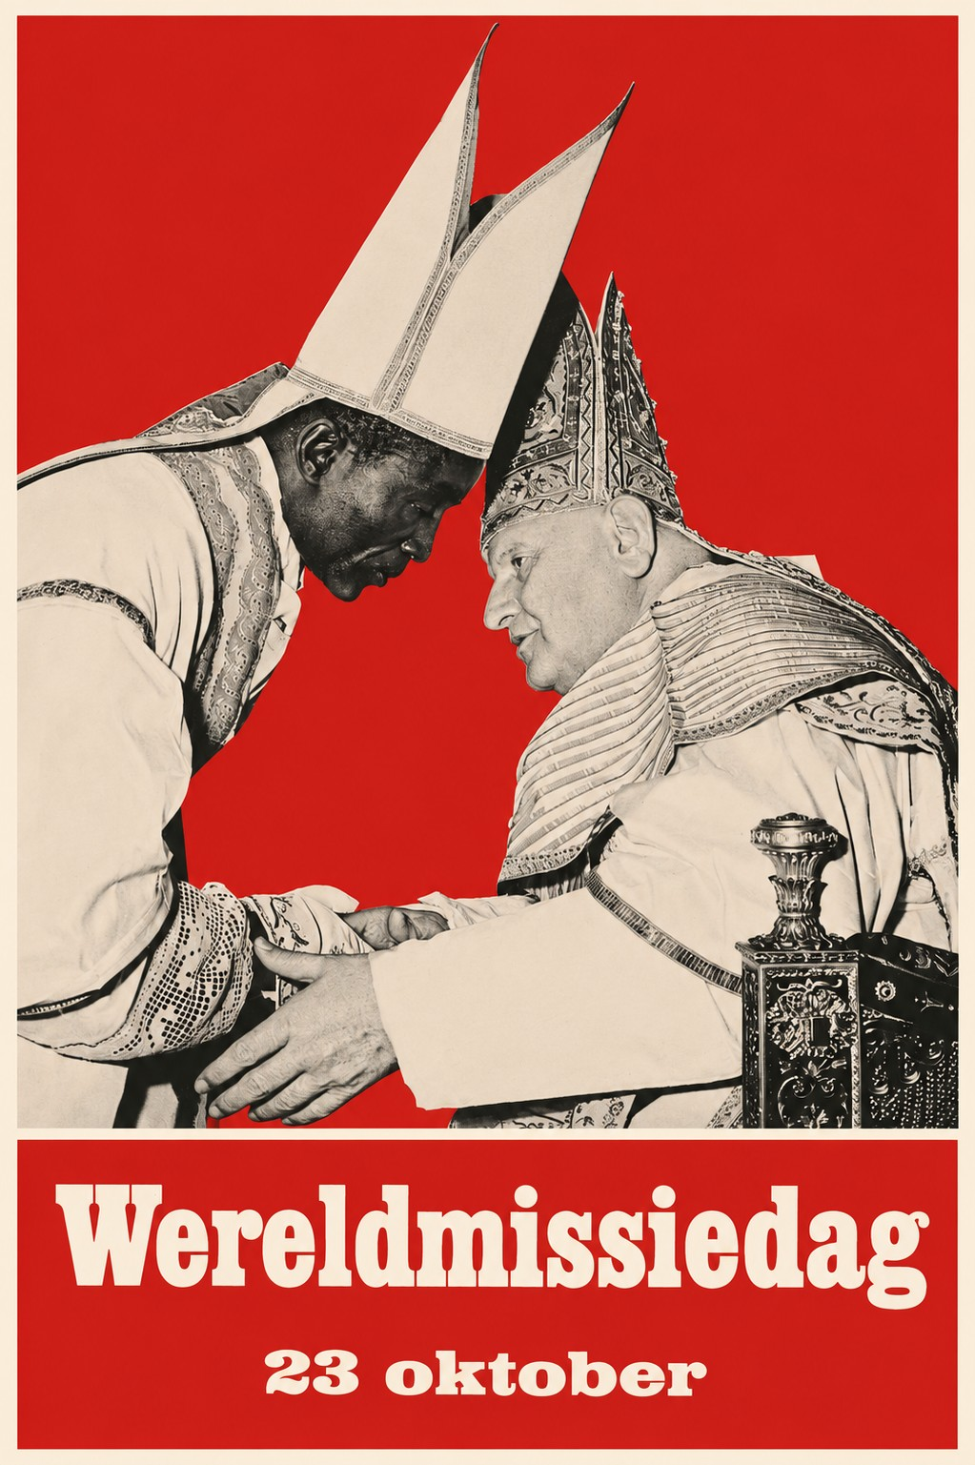
1966

Slide 42

1967

Slide 43

1968

Slide 44

1969

Slide 45

1970

Slide 46

1971

Slide 47
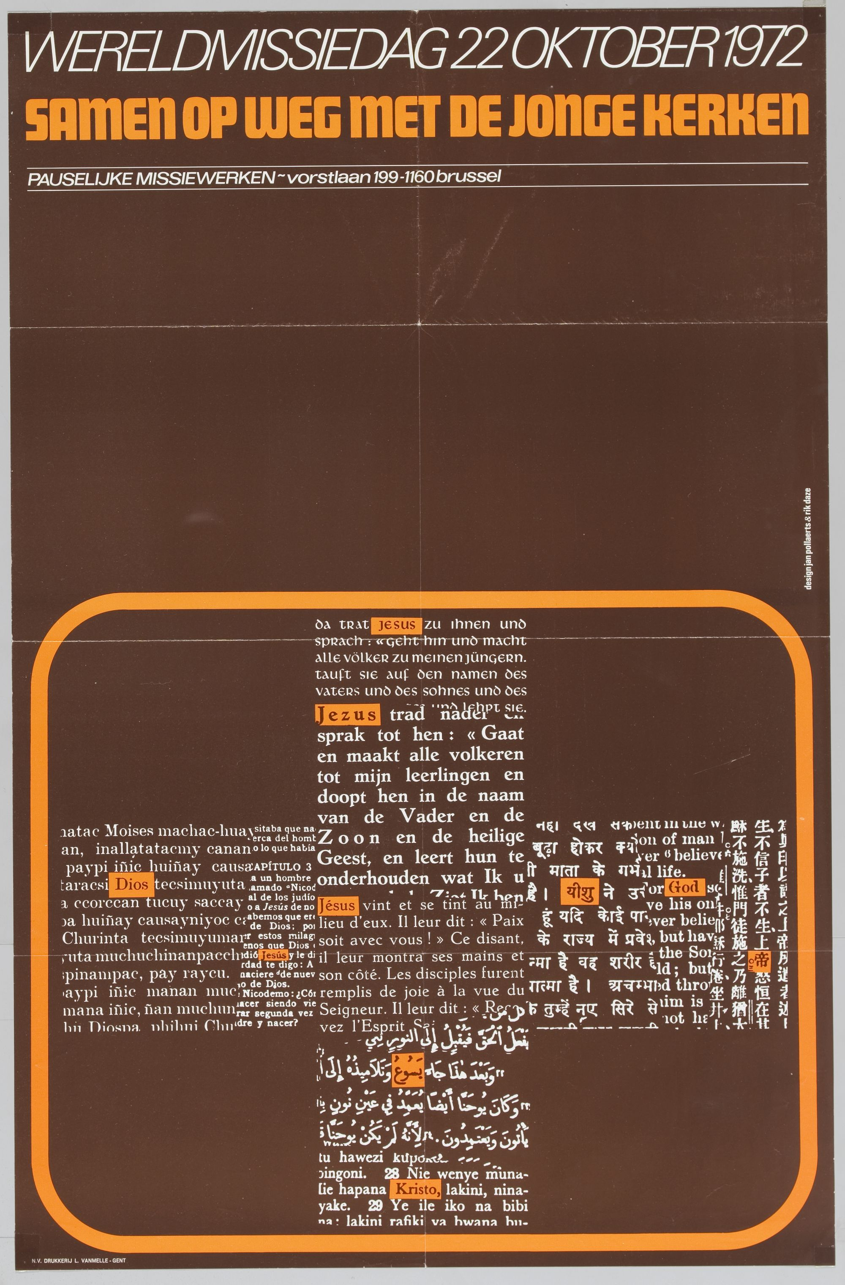
1972

Slide 48

1973

Slide 49

1974

Slide 50

1975

Slide 51

1976

Slide 52

1977

Slide 53

1978

Slide 54

1979

Slide 55
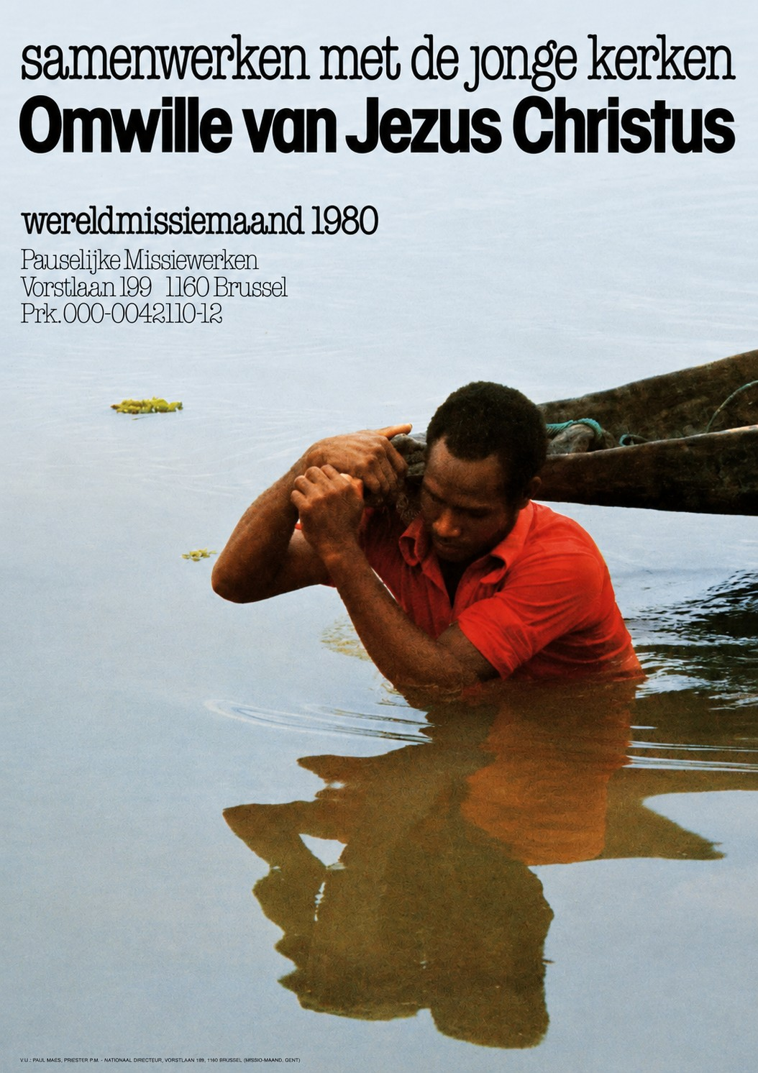
1980

Slide 56

1981

Slide 57

1982

Slide 58

1983

Slide 59

1984

Slide 60

1985

Slide 61

1986

Slide 62
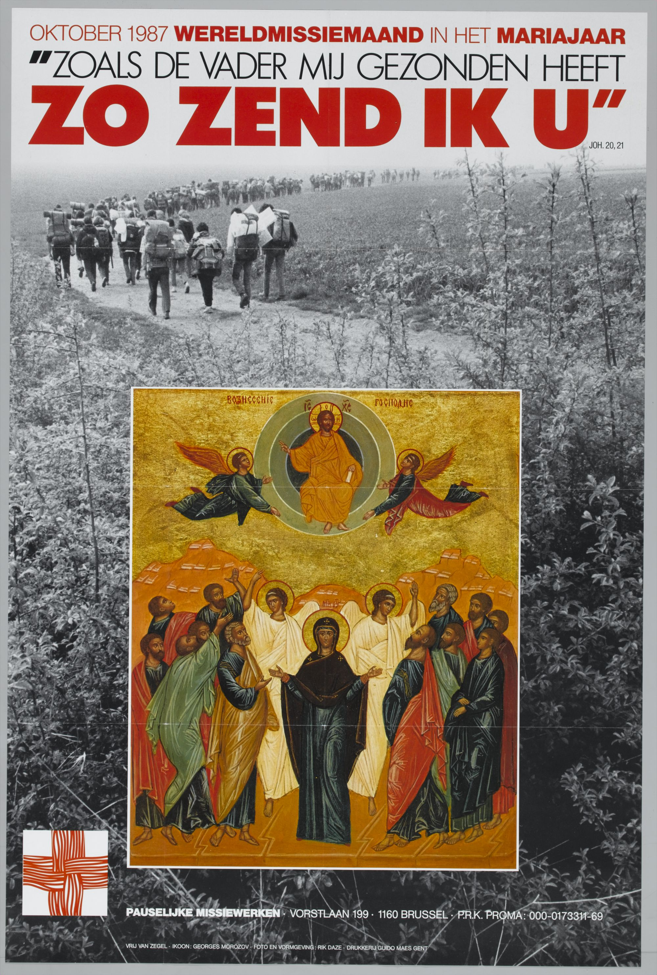
1987

Slide 63

1988

Slide 64
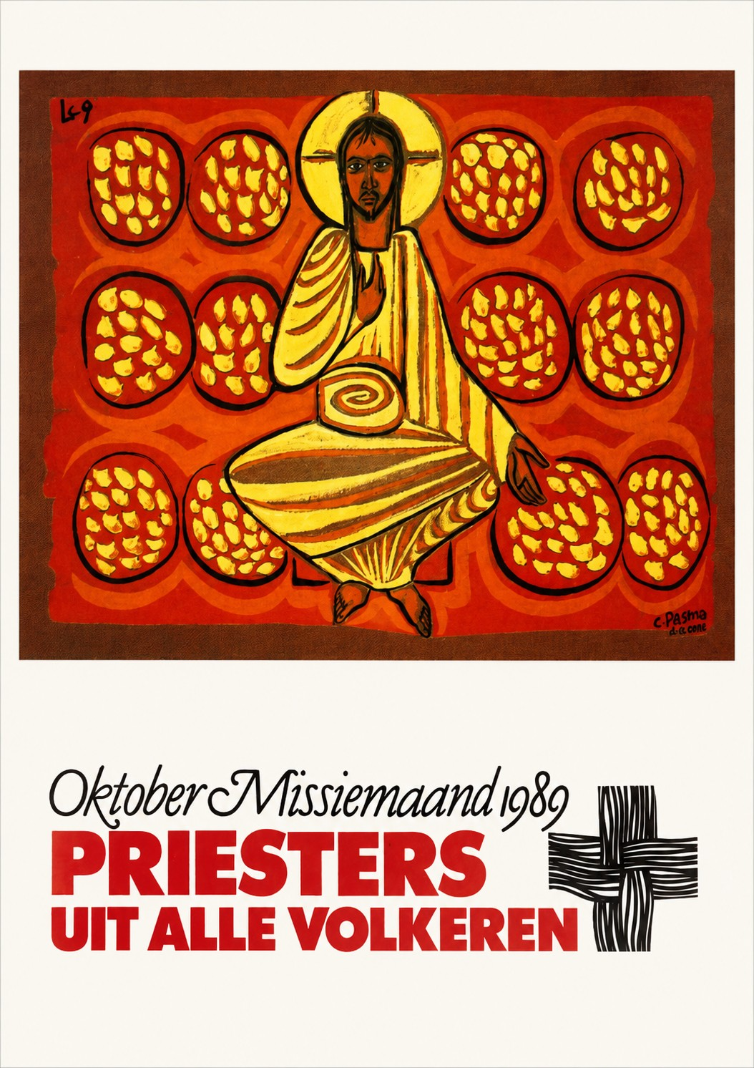
1989

Slide 65

1990

Slide 66
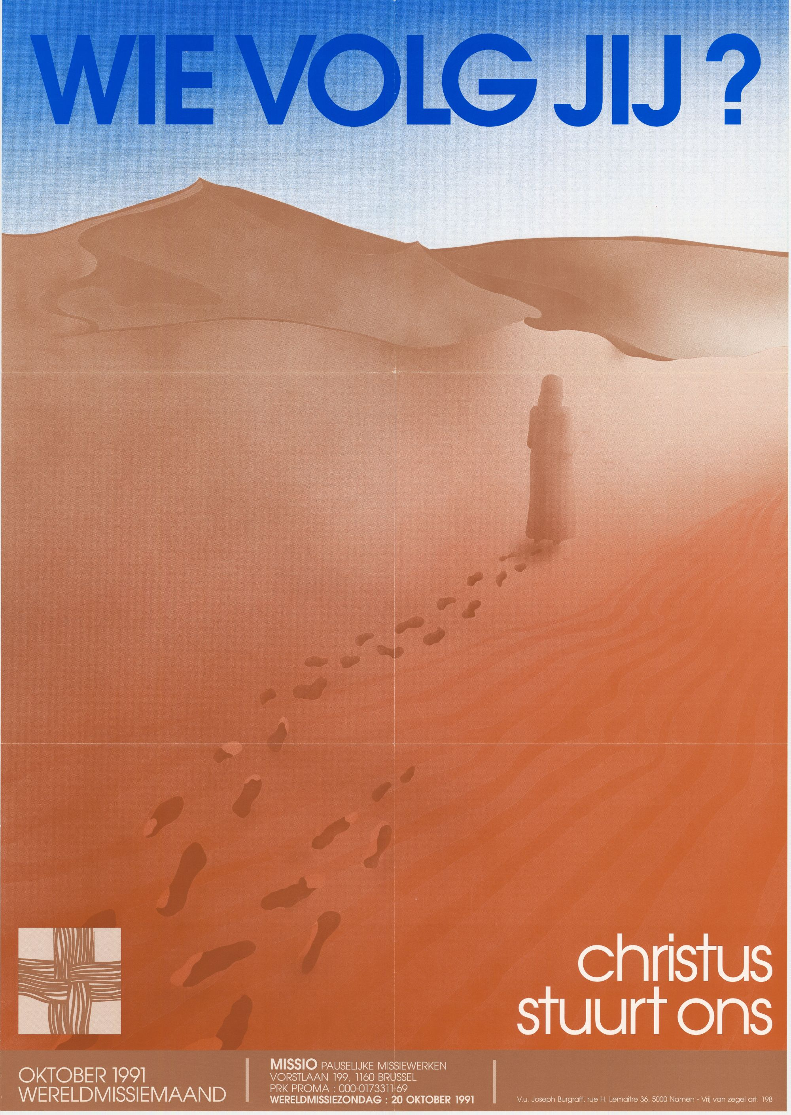
1991

Slide 67
1992

Slide 68
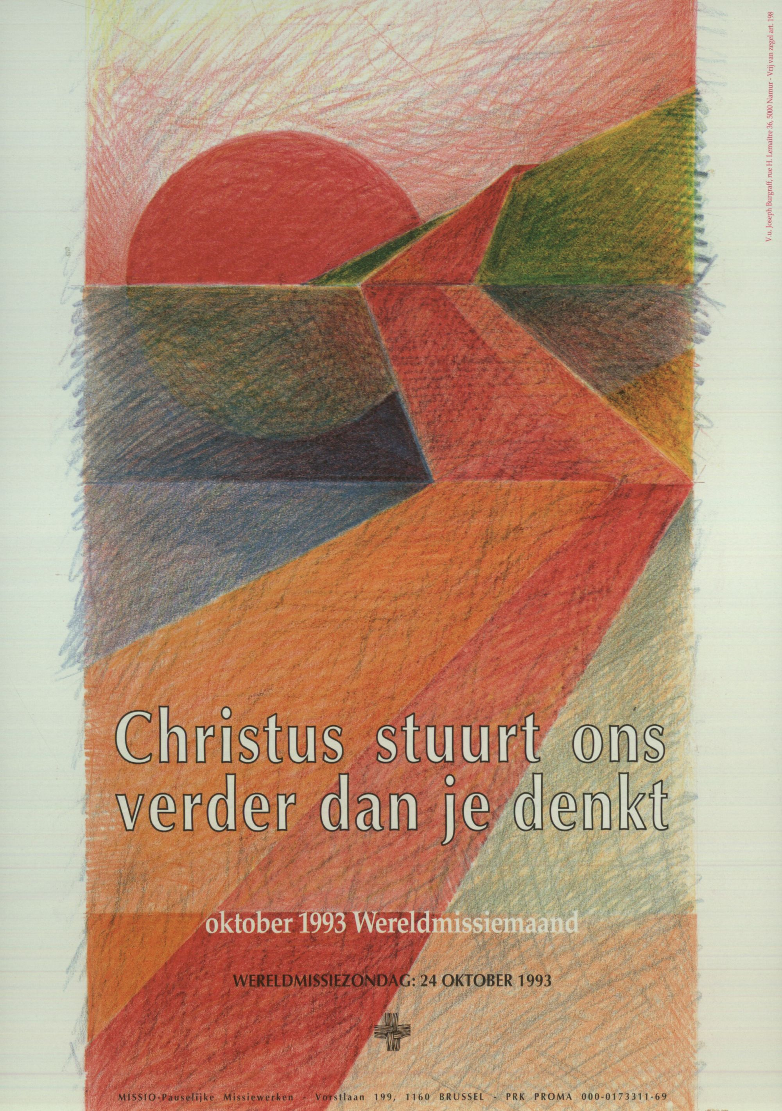
1993

Slide 69

1994

Slide 70

1995

Slide 71

1996

Slide 72

1997

Slide 73

1998

Slide 74

1999

Slide 75
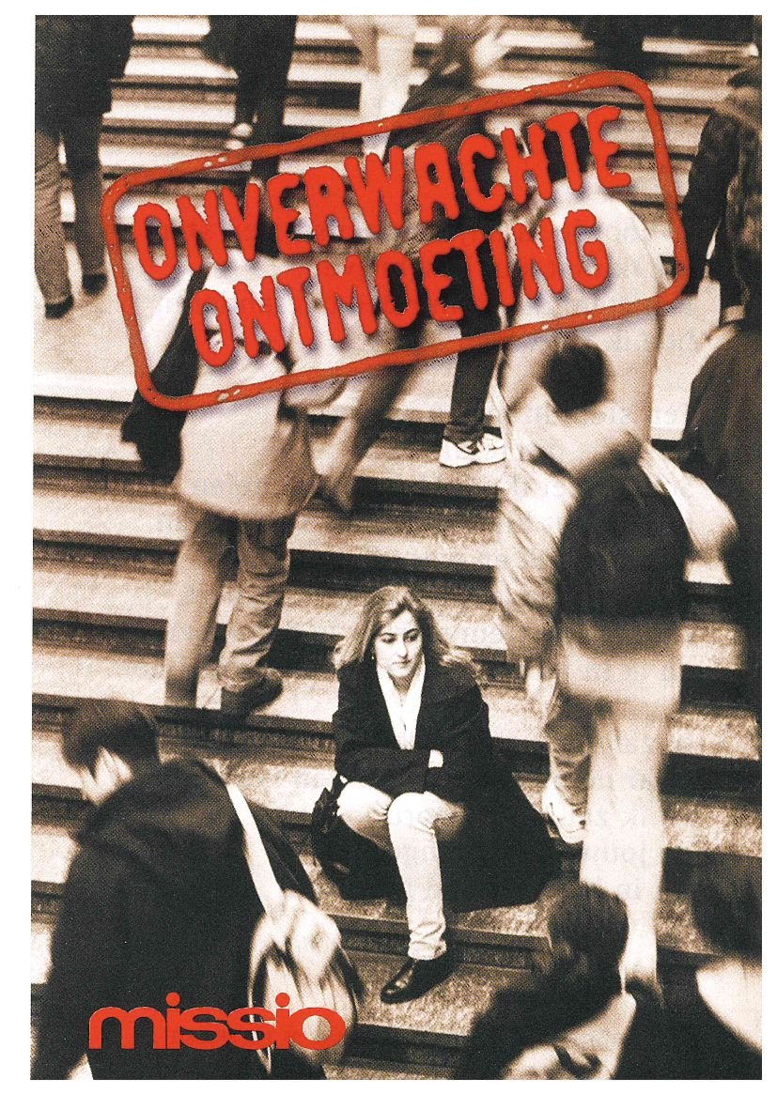
2000

Slide 76

2001

Slide 77
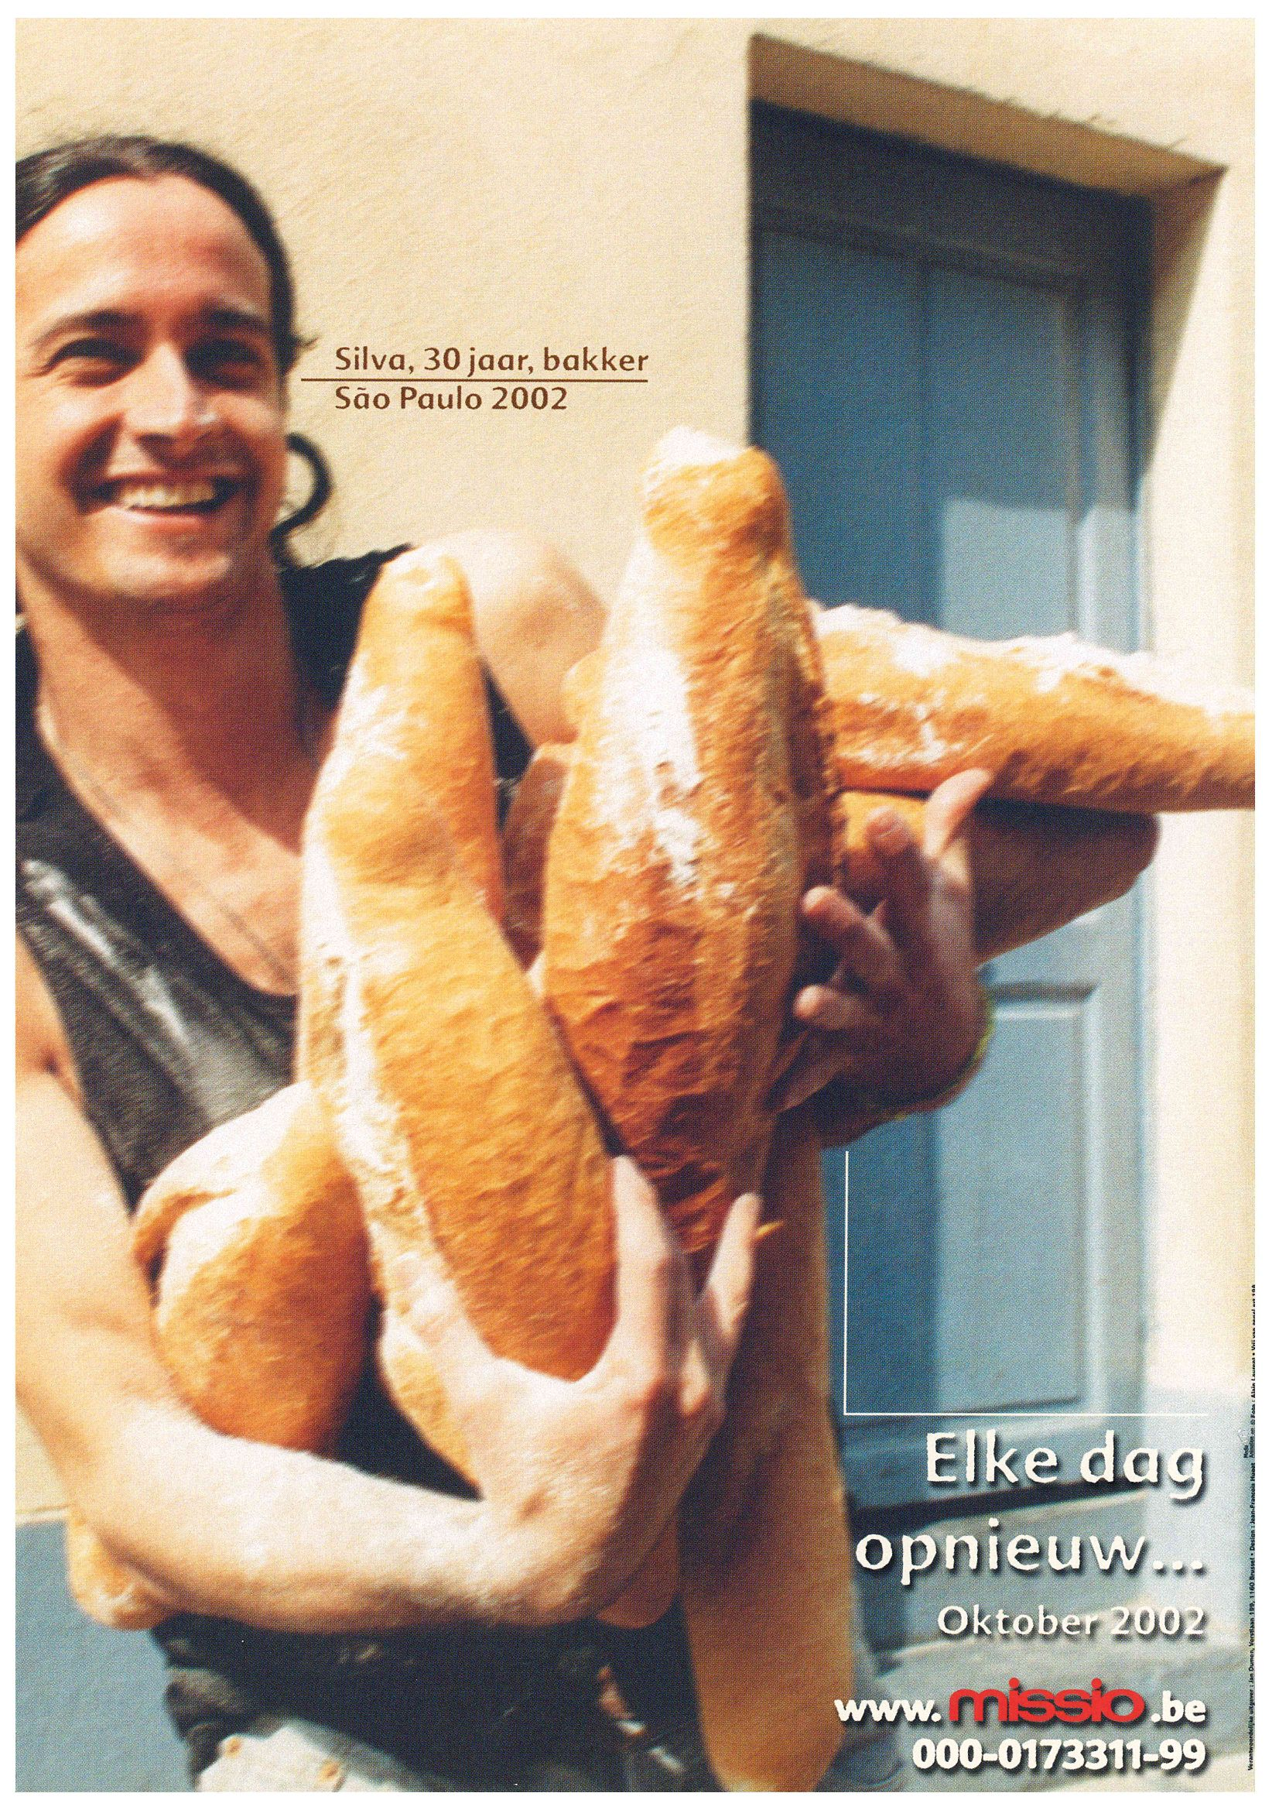
2002

Slide 78

2003

Slide 79

2004

Slide 80

2005

Slide 81

2006

Slide 82

2007

Slide 83

2008

Slide 84

2009

Slide 85

2010

Slide 86

2011

Slide 87

2012

Slide 88

2013

Slide 89

2014

Slide 90

2015

Slide 91
2016

Slide 92

2017

Slide 93

2018

Slide 94

2019

Slide 95

2020

Slide 96

2021

Slide 97

2022

Slide 98

2023

Slide 99

2024

Slide 100

2025

Slide 101

2026

